Slide 1

Get Ready for the New Internet: IPv.6
Class 1: Background & Overview of IP4 / IP6
September 8, 2014
Charles J. Lord, PE
President, Consultant, Trainer
Blue Ridge Advanced Design and Automation

Slide 2
This Week’s Agenda
9/8 Background & Overview of IP4 / IP6
9/9 Features of IPv.4 Versus IPv.6
9/10 Addressing in IPv.6
9/11 IPv.6: Traffic & Routing
9/12 Co-existing & Adopting IPv.6 – The Challenges

Slide 3
This Week’s Agenda
9/8 Background & Overview of IP4 / IP6
9/9 Features of IPv.4 Versus IPv.6
9/10 Addressing in IPv.6
9/11 IPv.6: Traffic & Routing
9/12 Co-existing & Adopting IPv.6 – The Challenges

Slide 4
The Big Bang

Slide 5
The Dawn of the Internet
Parallel development in academia and military
Routing was totally manual!
  decvax!mcnc!ecsvax (“!” is called a ‘bang’)
DARPANET developed the first numeric identifier system
MAC address -> IP address
At the advent of the first public release, Internet Protocol was to version 4: IPv4

Slide 6
RFC 2235
http://tools.ietf.org/html/rfc2235
Packets proposed in 1962
ARPANET plan 1967
Internet invented 1973
UUCP in Unix 1977
USENET 1979
IP ‘version 1’ 1982 TCP/IP
Name servers 1983

Slide 7
More History
IPv4, the first released, cutover Jan 1983
DNS 1984
1986 NSF backbone / NNTP / IETF
1987 UUNET – birth of commercial net
1990 OSI/ISO
1991 Birth of the WWW
1995 WWW surpasses all other net traffic
1995 IPv6 first draft

Slide 8
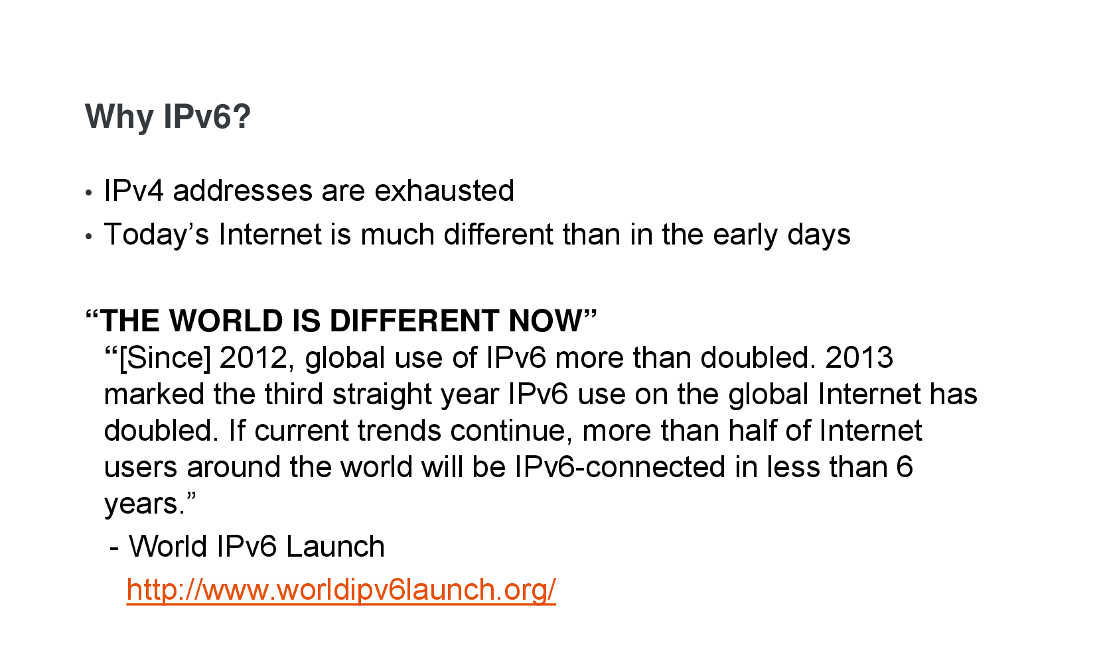

Slide 9
Some Numbers
World population is currently around 7.26B
Number of cars in the world passed 1B in 2011
IPv4 had a total of 4,294,967,296 theoretical addresses
IPv6 has a total of 340,282,366,920,938,463,463,374,607,431,768,211,456 theoretical addresses – but only uses 1/8 of these!
6.6x10²³ addresses per square meter of the earth (including the oceans and ice)
Q.E.D. – we have enough…
…for now…

Slide 10
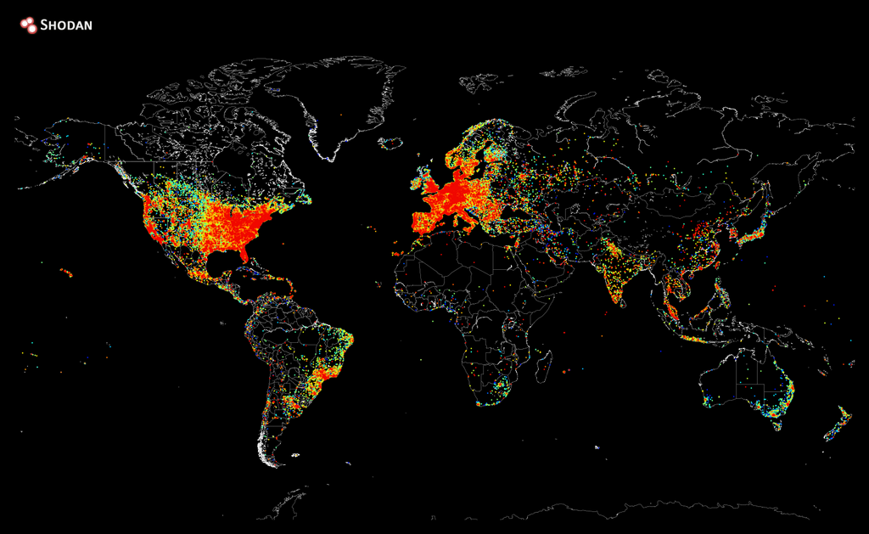

Slide 11
IPv4 in Ten Minutes
Packet Based communications
32-bit address, broken into 4 octets (bytes)
Address expressed as four decimal numbers from 0..255 – e.g. 217.5.34.101
Different classes of addresses based on how many of these numbers unique:
  Class A 217.x.x.x etc
  Masks used to determine what we look at
  e.g. 255.0.0.0

Slide 12
IPv4 Over Ethernet
IP address 192.168.1.106
MAC (physical) address E4-D5-3D-52-73-B5
Ethernet Address is the MAC address
May have a name address
  Top domain com
  Second domain blueridgetechnc
  Optional subdomain www, blog, etc

Slide 13
Some Key Elements
TCP – Transmission Control Protocol
UDP – User Datagram Protocol
ICMP - Internet Control Message Protocol
ARP – Address Resolution Protocol
DNS – Domain Name Server
Etc etc etc

Slide 14
TCP – Transmission Control Protocol
‘primary’ form of packet
Connected communications, from point a to point b through a ‘socket’
Checksum mandatory
Re-send until acknowledged
Time limited
When it HAS to get through; mechanism is through this layer

Slide 15
UDP – User Datagram Protocol
The second primary data packet
Generic
Checksum is optional, rarely used
No delivery guaranteed, no handshake
Delivery acknowledgement, if needed, is handled at higher levels

Slide 16
ICMP - Internet Control Message Protocol
Control – NO data other than internal to the system
All error messages
Flow control
“Ping” is one function
Common local hack target

Slide 17
ARP – Address Resolution Protocol
Used for local network discovery
Resolves physical address to IP address (within local mask)
Typically the most prevalent packets in a local network

Slide 18
DNS – Domain Name Server
System of global and local servers that together resolve all registered domain names to an IP address
No one server – all higher level servers are aware of the lower level servers
A node typically has a fixed first server to begin the search – typically provided by the ISP

Slide 19
IPv4 Architecture
Ping
FTP
TELNET
HTTP
DNS
RTP
SNMP
SMTP
BGP
RIP
ICMP
TCP
UDP
OSPF
IPv.4
LANs
ATM
FR
PPP
CDPD
10/100BaseT
Dedicated B/W: DSx, SONET, ...
Circuit-Switched B/W: POTS, SDS, ISDN, ...
Mobile

Slide 20
This Week’s Agenda
9/8 Background & Overview of IP4 / IP6
9/9 Features of IPv.4 Versus IPv.6
9/10 Addressing in IPv.6
9/11 IPv.6: Traffic & Routing
9/12 Co-existing & Adopting IPv.6 – The Challenges

Slide 21
Please stick around as I answer your questions!
Please give me a moment to scroll back through the chat window to find your questions
I will stay on chat as long as it takes to answer!
I am available to answer simple questions or to consult (or offer in-house training for your company)
c.j.lord@ieee.org
http://www.blueridgetechnc.com

